Slide 1
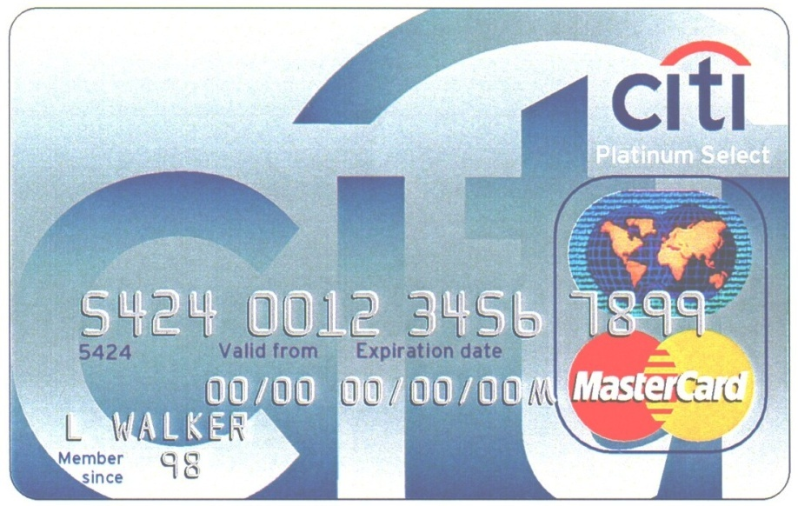
Foundations of Profit and Loss
1Q 2014
Citi Cards
Citi Cards Proprietary and Confidential
Notes:
1

Slide 2
Course Objective
This course is designed to enhance your level of understanding of the Citi Cards Profit and Loss dynamics.
The course will outline “how the business makes money” and the correlation between key drivers of the business and the business strategy.
Notes:
Welcome
Let me introduce myself and my co-facilitator
Explain need to introduce each individual
Want to hear name, role/dept, time in Cards, and objectives for course
Emphasize expectations
Completed pre-reading?
Let’s take a look at objectives and agenda

Slide 3
Agenda
Purpose of the P&L
Components of the P&L
Financial Overview
Profitability Drivers
Ending Net Receivable (ENR) Roll Forward
Interest Income and Average Net Receivable (ANR) by Price Point
Cost of Funds (COF)
Net Interest Margin (NIM)
Other Revenue
Net Credit Losses (NCLs)
Earnings
Financial Analysis Tools
Risk Capital
Competitive Environment
Marketing Spend Analysis
CARD Act
Notes:
Welcome
Let me introduce myself and my co-facilitator
Explain need to introduce each individual
Want to hear name, role/dept, time in Cards, and objectives for course
Emphasize expectations
Completed pre-reading?
Let’s take a look at objectives and agenda

Slide 4
Purpose of the P&L
A P&L is used for:
Shareholder Value Management
Management Report
Performance Management
Strategic Planning
Evaluate Competition
Evaluate Investment Opportunities
Corporate Reporting
Notes:
Welcome
Let me introduce myself and my co-facilitator
Explain need to introduce each individual
Want to hear name, role/dept, time in Cards, and objectives for course
Emphasize expectations
Completed pre-reading?
Let’s take a look at objectives and agenda

Slide 5
High Level Credit Card P&L – 2013 Actuals
$MM
Total Revenue $8,211
- Net Credit Losses (NCL) $2,576
Net Credit Margin (NCM) $5,635
Expenses $2,946
Core Earnings before Taxes (Core EBIT) $2,689
- LLR ($535)
Earnings before Taxes (EBIT) $3,224
- Taxes $1,215
Net Income (NI) $2,009
Notes:
Review components line by line – keep it general, stating that we’ll treat each of the lines in greater detail
Transition: Now let’s get a sense of the relative size of the various components of the P&L

Slide 6
Components of the Credit Card P&L
P&L Line Item
Interest Revenue (EIR)
- Cost of Funds (COF)
Net Interest Margin (NIM)
- NCL Adjustments and Refunds
+ Delinquency Fees
+ Balcon Fees
+ Other Net Interest Revenue
Net Interest Revenue
+ Interchange
- Affinity Rebates
+ Cross Sell Revenue
+ Annual Fees
+ Other Non Interest Revenue
Non Interest Revenue
Total Revenue
- Net Credit Losses (NCL)
Net Credit Margin (NCM)
Expenses
LLR
Earnings before Taxes (EBIT)
Net Income (NI)
Description
The amount of money charged by the bank for lending via the credit card
Cost to the bank of carrying the receivables
Interest - COF = Net interest income on total interest-earning assets
Written Off Interest Revenue
Fees for making a Late Payment
Balance Transfer fees; typically 3-5% of Balance Transfer
Includes: Cash Transaction Fees, OCL Fees, Other Revenue (NIR)
Sum of above
Amount earned by the bank for every dollar of sales
Amount of sales paid in mainly “Thank You” Points, Miles (AA) and Cash Back
Ancillary Fee Based products
Annual membership fees
Includes: FX Fees, Bad Check Fees, Speedpay, Fastcard Fees, FAS 91 Reversal, Revenue Share
Sum of Interchange Revenue through Other Non Net Interest Revenue above
Sum of Net Interest Revenue + Non Interest Revenue
$ Balances Charged-off Unpaid less Recoveries and Receivable Sales
Total Revenue - NCL = Risk Adjusted Margin
Includes O&T Expenses, Marketing and Advertising, All Other Expenses
Loan Loss Reserve Release or Build
Pre-tax Earnings
EBT x (1 - corporate tax rate) = Earnings After-Tax
Notes:
Review components line by line – keep it general, stating that we’ll treat each of the lines in greater detail
Transition: Now let’s get a sense of the relative size of the various components of the P&L

Slide 7
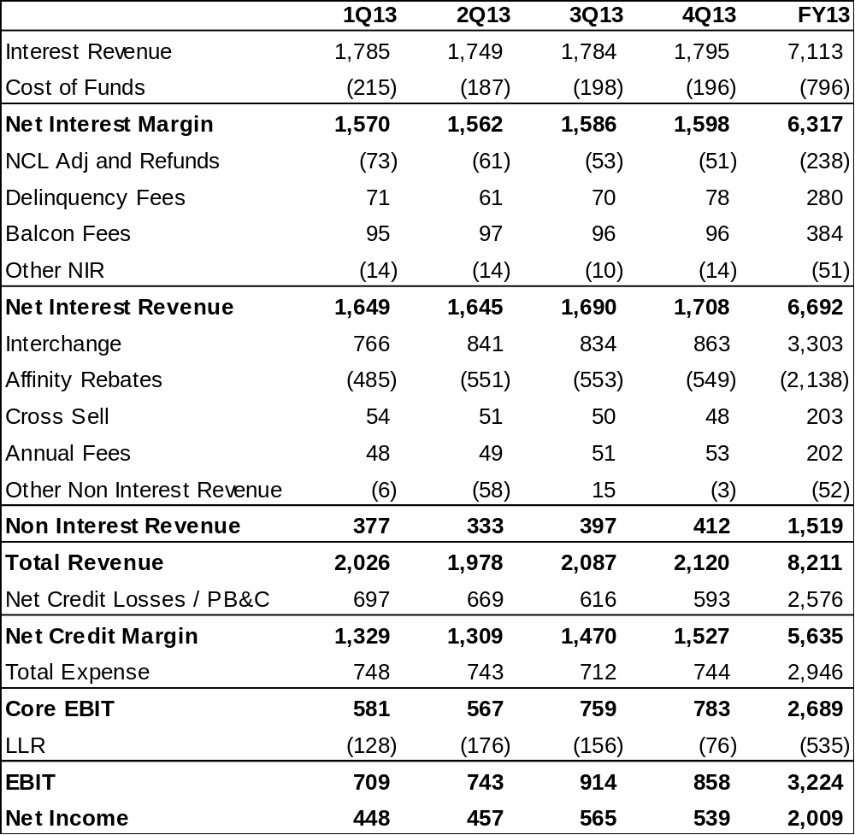
Financial Overview – 2013 Actuals
Notes:
Review components line by line – keep it general, stating that we’ll treat each of the lines in greater detail
Transition: Now let’s get a sense of the relative size of the various components of the P&L

Slide 8
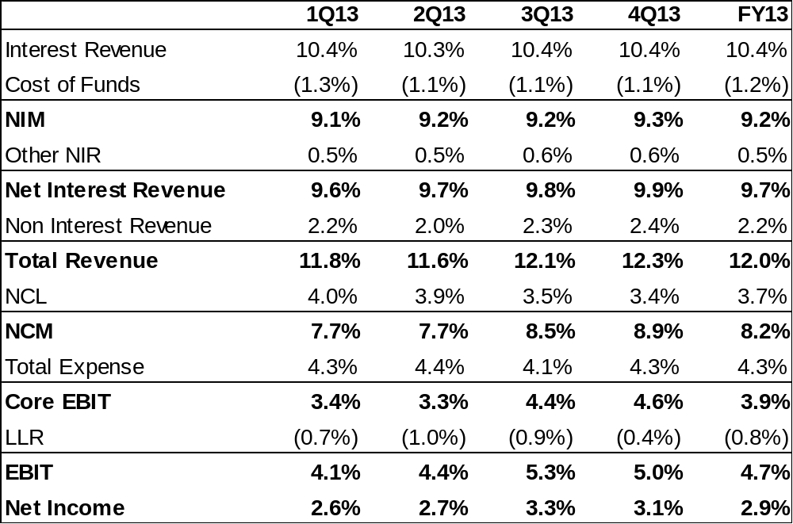
Financial Overview (% ANR)
Notes:
Review components line by line – keep it general, stating that we’ll treat each of the lines in greater detail
Transition: Now let’s get a sense of the relative size of the various components of the P&L

Slide 9
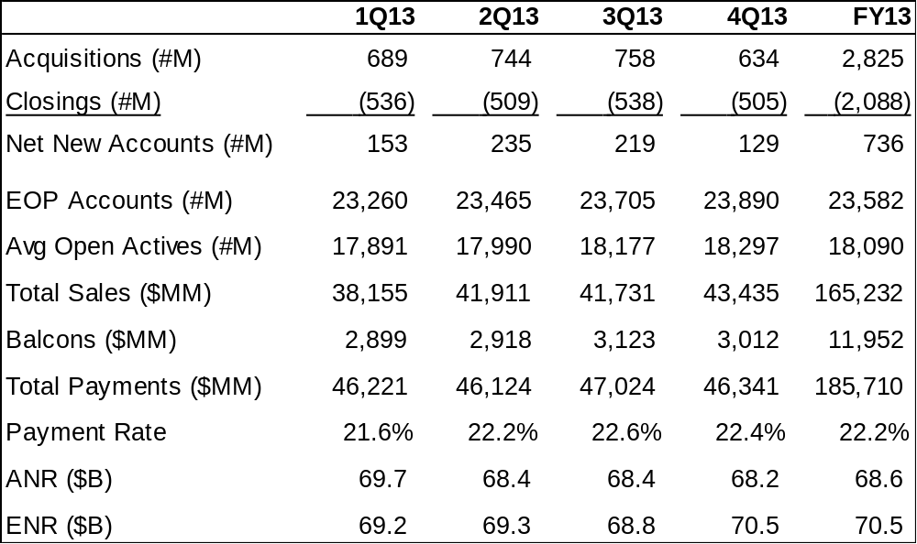
Key Business Drivers - 2013
Notes:
We can also look at the drivers in terms of accounts and behavioral characteristics
Briefly review definitions
Transition: Let’s focus for a minute on attrition

Slide 10
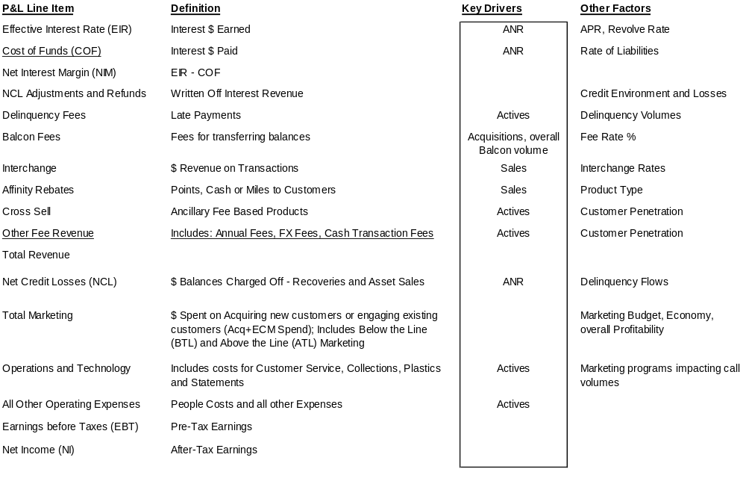
Profitability Drivers
Notes:
Review the drivers of each line item
Ask group how they influence the P&L in their daily jobs
Transition: Now we’re going to look at some of the drivers in more detail

Slide 11
Driver Definitions
Accounts
Acquisitions: Number of accounts acquired or added to the portfolio in a given time period
Closing/Attrition: Number of accounts removed from the portfolio in a given time period. This may be due to voluntary closing - at the customer’s request, or involuntary closing - at the bank’s request.
Net New Accounts: Acquisitions less Closings
EOP Accounts: Number of Accounts on the books at the end of the month, whether active or inactive.
Active Accounts: Accounts which receive a statement each month.
Behavioral Characteristics
Sales: Amount of dollars charged on the credit card
Revolve rate: Percent of ANR that earns interest
Payments: Amount of money which is deducted from total receivables as customers pay their bills
ANR / ENR: Receivables is a function of sales, revenue, NCL and payments (see receivables flow)
Notes:
We can also look at the drivers in terms of accounts and behavioral characteristics
Briefly review definitions
Transition: Let’s focus for a minute on attrition

Slide 12
Ending Net Receivables - ENR
Receivable is the output of customer behavior and is one important driver of profitability.
Receivable (ENR) appears on the balance sheet, not the P&L.
Portfolio Receivable Flow
$1,000
$100
$50
($100)
Prior Month
Ending Net
Receivable
plus
Current
Month
Purchase/Cash
plus
Current
Month
Balcons
minus
Current
Month
Payments
equals
Current
Month
ENR
minus
Net
Credit
Loss
plus
Current
Month
Fees
plus
Current
Month
Interest
$1,050
($50)
$30
$20
Notes:
What business are we in?
Lending money
When you lend someone money, what do you expect?
To be paid back (you have an IOU)
With interest
ENR is the total “IOU”s on our books
Reveal each item
Transition: Now we’ll have a chance to practice calculating ENR

Slide 13
Exercise #1 – Calculating ENR
Beg ENR $2,000
Net Credit Losses 100
Late Fees 30
Interest 20
Payments 200
Balcon 100
Cash Advance 30
Purchases 300
Ending Balance $ ???
Notes:
“You should indicate whether the lines should be added or subtracted and perform the calculations”
Have a volunteer walk through the calculation at the flip chart
Transition: Now let’s go back to the key line items of the P&L, starting with Interest Income

Slide 14
Interest Income
Interest Income = ANR x EIR% (Effective Interest Rate)
APR (Annual Percentage Rate)
APR = Index (e.g. Prime) + Spread (Variable)
  Fixed (e.g. 0% APR for 12 months)
EIR% = APR x Revolve Rate
Prime = 6.8%
APR Spread + 6.6%
APR =13.4%
APR = 13.4%
Revol Rate x 88.0%
EIR = 11.8%
Notes:
As we saw, interest is the largest slice of the revenue pie, and the single largest item on the income statement
Interest = ANR * EIR%
EIR% is the product of the APR and Revolve Rate
APR is the interest rate we all see on the offers we get and our statements
Fixed
Variable (usually Prime + X%)
Reveal Variable APR calculation
Reveal EIR% calculation
Break: After the break you’ll have a chance to calculate EIR%

Slide 15
Exercise #2 - Interest Income
ANR $100Bn
APR 15.0%
Spread 5.0%
Revolve Rate 85%
What is the EIR (%&$) ?
What is the implied Prime Rate?
  What happens to the EIR (%) if the Prime Rate increases by 50bps?
Notes:
Ask a volunteer to complete the calculations at the flip chart
EIR: 15% APR * 85% RR = 12.75% EIR = $12.75MM
Implied Prime = 15%-5% = 10%
50bps Prime Increase = 50bps * 85% = 42.5bps
New EIR% = 13.18%
Add’l interest = $425M
Transition: now let’s look at some of the factors that drive interest income

Slide 16
Interest Income Drivers
The key drivers of interest income are:
  Nominal Rates (Prime or LIBOR)
  “Go To Rates” (Prime or LIBOR plus a spread)
  Promotional Rates & Period
    Introductory Rates (Acquisition Intro)
    Balance Transfers (Acquisition and ECM Intro)
  Risk Based Rates
  Revolve Rate
    Percentage of balances that earn interest
  Payment Hierarchy - Application of payments
Notes:
What drives interest income? Discuss:
We always want to earn more interest than we are paying, so the rates that we can borrow at are an important driver (Nominal→ Go To)
Our offers/promotions
Risk based Rates (& customer behavior)
Revolve rate
Payment Hierarchy (Payments go to lowest rate balances first)
Transition: As we’ve discussed, balcons are an important part of our strategy to increase balances. Let’s look more closely at balcons

Slide 17
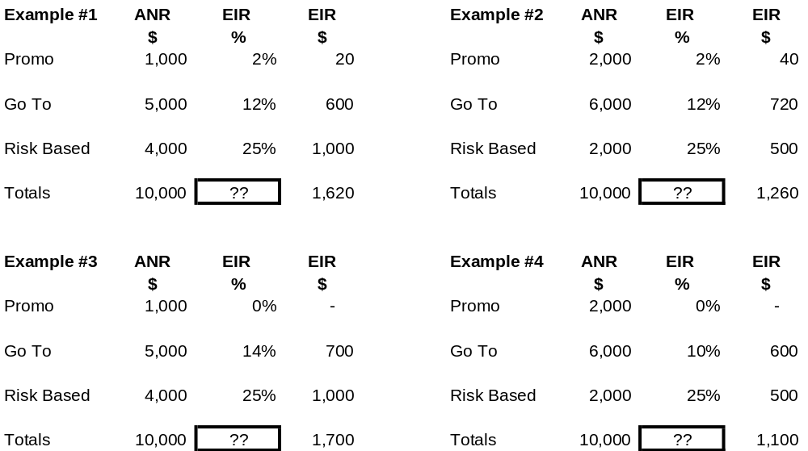
ANR by Price Point (Examples)
Note: ANR * EIR% = EIR$
Notes:
Define “price point”, Promo, Go To and Risk Based “buckets”
Box 1: What’s the EIR%? 16.20%
Box 2: What changed? More $ in Promo and Go To, less in Risk-Based, same rates. EIR: 12.60%
Box 3: Same amounts as Box 1, but Promo rate is 0%, Go To rate slightly higher. EIR: 17%
Box 4: Same amounts as Box 2, but 0% promo, lower Go To. EIR: 11%
Transition: to sum up, the interest line is a huge part of our P&L. Managing it well is very important.

Slide 18
Cost of Funds
COF is dependent on the interest rate environment.
  Influenced by Fed action
Funding for Citi Cards is managed by the Treasury group.
The Treasury group manages COF via a mix of internal and external funding.
Notes:
The interest we PAY other sources for the money we borrow is called the “Cost of Funds”
It’s the 2nd line on the P&L just under interest. It’s a negative item and rolls into Revenue as a “Contra-Revenue” – because it’s so closely related to the interest we earn.
Explain bullet points
ALCO = Assets & Liabilities Committee

Slide 19
Cost of Funds
Funding can either be a fixed or a floating rate:
Floating Rate - Also called variable rate because it changes periodically (quarterly, monthly, or daily) depending on general market interest rates that are influenced by Fed action.
Floating Rates Indices:
    LIBOR (London Interbank Offered Rate)
    Fed Funds
    Commercial Paper
    Prime Rate
    T-Bill Rate
Fixed Rate - Rate of interest is fixed for the term of the loan. Funding at a fixed rate generally costs more than variable rate funding and depends on the shape of the yield curve. The "usual shape" is positive; that is, with short rates lower than long.
Notes:
We fund our portfolio with a mix of floating and fixed rates
Draw fixed rate yield curve on flip chart: why are shorter rates lower than long? (example: lend a friend money for a month or 5 years?)
Transition: So what are the primary drivers of Cost of Funds?

Slide 20
Cost of Funds
The Total Cost of Funds (COF) is based on the type of balance:
  Promo balances are funded by 5 year fixed rates.
  Floating balances are funded by 1 month LIBOR rates.
  Fixed balances are funded by 5 year fixed rates.
The Cost of Funds rate and dollars for an individual portfolio depends on the mix of the portfolio in terms of how much of the portfolio is Promo balances, Floating balances and Fixed balances.
Example - blended Cost of Funds rate:
  Promo 1,000 x 3.0% = 30
  Floating balances 5,000 x 1.5% = 75
  Fixed balances 4,000 x 3.0% = 120
  TOTAL 10,000 x 2.15% = 225
ANR
Rate
COF $

Slide 21
Cost of Funds Drivers
Market Interest Rate (driven by Fed policy)
Funding Sources are mainly:
  Securitization
  Internal company funds
  Deposits
Asset Mix:
  Fixed rate loans
  Variable rate loans
Customer Mix:
  Revolvers
  Transactors
Notes:
Review bullet points
Give example of mismatch of consequences of mismatched asset/liability positions on flip chart:
Fixed rate lending in a rising rate environment
This is why it’s so important to be match funded
How do we fund transactors? Fixed. Why?
Discuss gap
Transition: So taken together, the Interest and COF make up our Net Interest Margin, or NIM

Slide 22
NIM Drivers
There are a number of factors that can influence NIM besides the type of customer and market interest rates:
Market Risk - this risk is created when an issuer adjusts lending rates due to competitive pressures or lowers introductory rates to gain market share
Asset and Liability Management (ALM) Risk - to minimize impact to NIM from interest rate volatility, an issuer tries to match the duration of their assets and liabilities (e.g. fixed rate loans using fixed rate funding)
Basis risk - this risk is created due to change in the spread between prime and LIBOR. Most funding today is LIBOR based, however lending is mainly prime rate based. To minimize basis risk, an issuer will generally match LIBOR based funding with LIBOR based lending
Transactor risk - cardholders that do not revolve each month require the issuer to provide a free float. In an increasing rate environment, this can increase the cost of financing the float.
Notes:
NIM is the 3rd line on the P&L and reflects the balance between Interest and COF, but is closely tied to COF. As COF rises, NIM will generally decrease (rising rates impact COF immediately, customer APRs lag, if variable and do not change, if fixed)
Discuss risks highlighted in bullet points
Basis risk: LIBOR is forward looking and incorporates expected changes in prime
Transition: Now lets do an exercise that will help us understand NIM

Slide 23
Exercise #3 - Net Interest Margin
APR 14.5%
Spread 5.0%
Revolve Rate 85%
COF 6.5%
What is the NIM (%)?
Assume that the APR is fixed, yet COF is variable.
  What happens to NIM if the Fed increases rates by 50bps?
  What happens to NIM if the Fed decreases rates by 50bps?
Notes:
Ask volunteer to complete the exercise on the flip chart
Transition: Let’s take a look at the business from a wholistic point of view

Slide 24
Delinquency Fees
Delinquency Fees (also known as Late Fees)
    A late payment fee is charged to a borrower who misses paying at least their minimum payment by the payment deadline.
    Delinquency Fees are $25; or $35 for any additional past due payment during the next six billing periods after a past due payment.
    Card Act changes: Late Fee Reasonableness, Monthly Statements must be mailed at least 21 days before the due date.
    Represented $280MM of Revenue in 2013.
Notes:
Other Revenue is primarily fee-driven
Review bullet points
Interchange & Affinity Rebates are sales/driven, and do not impact the customer
Rebates are a contra-revenue
Other fees: Cash Txn Fee, Balcon Fee, Speedpay, FX Fees
Adjustments include Interest & Fee write-offs; other accounting items (FAS 91 Reversals, FAS 140 Gains, etc…)
Transition: Again, as with interest & COF, there are key drivers related to other revenue

Slide 25
Balance Consolidations (Balcons)
A Balcon is the transfer of balances from non-Citi credit cards to a Citi Card accounts. Balcons are usually initiated through marketing programs and often reflect special pricing terms and conditions.
Balcon Fees are the amount a card member pays to transfer a balances from a competitor to their Citi Card.
  Balcon Fees range from 3-5% of the amount of the transferred balance. For example, a $5,000 balance transfer with a 3% fee will be charged $150.
  For Full Year 2013 (Acquisition + ECM):
    84% of Balcon offers have a 3% Fee
    5% of Balcon offers have a 4% Fee
    11% of Balcon offers have a 5% Fee
    Average Balance Transfer is $4,006
    Average Balcon Fee is $130 or 3.24%
Notes:
Other Revenue is primarily fee-driven
Review bullet points
Interchange & Affinity Rebates are sales/driven, and do not impact the customer
Rebates are a contra-revenue
Other fees: Cash Txn Fee, Balcon Fee, Speedpay, FX Fees
Adjustments include Interest & Fee write-offs; other accounting items (FAS 91 Reversals, FAS 140 Gains, etc…)
Transition: Again, as with interest & COF, there are key drivers related to other revenue

Slide 26
Other Net Interest Revenue (NIR)
Consists of:
  Cash Transaction Fees – a fee charged for taking a Cash Advance on a Citi account.
  Over the Credit Limit Fees (OCL Fees) – a fee charged when you exceed your credit limit. Fee can only be charged to Business card customers post CARD Act.
  Other Revenue (NIR)
Notes:
Other Revenue is primarily fee-driven
Review bullet points
Interchange & Affinity Rebates are sales/driven, and do not impact the customer
Rebates are a contra-revenue
Other fees: Cash Txn Fee, Balcon Fee, Speedpay, FX Fees
Adjustments include Interest & Fee write-offs; other accounting items (FAS 91 Reversals, FAS 140 Gains, etc…)
Transition: Again, as with interest & COF, there are key drivers related to other revenue

Slide 27
Interchange
Merchant Discount is the fee an acquirer or merchant bank charges the merchant to cover the costs of providing deposit credit and handling the merchant’s bankcard sales transactions.
Interchange fees are fees paid by the acquirer or merchant bank to the issuer for risk of loss (fraud and credit losses) and the cost of processing the transaction. Interchange fee rates are established by the networks (MasterCard, Visa, American Express).
  Interchange Rate is the Interchange Revenue / Purchase Sales. For NA Cards in 2013, the Interchange Rate was 2.01% for the business
Cash Interchange is the reverse of interchange fees when an issuer pays the cash disbursing member a fee for providing cash advance to a cardholder.
Notes:
Other Revenue is primarily fee-driven
Review bullet points
Interchange & Affinity Rebates are sales/driven, and do not impact the customer
Rebates are a contra-revenue
Other fees: Cash Txn Fee, Balcon Fee, Speedpay, FX Fees
Adjustments include Interest & Fee write-offs; other accounting items (FAS 91 Reversals, FAS 140 Gains, etc…)
Transition: Again, as with interest & COF, there are key drivers related to other revenue

Slide 28
Affinity Rebates
A contra revenue P&L item designed to increase loyalty and stimulate purchases.
“Thank You” points, Cash rebates or Airline miles are awarded to the card member typically for making purchases.
The points, cash rebate and/or miles earned varies significantly by product.
The Affinity Rebate Rate is the Affinity Rebates / Purchase Sales. For NA Cards, in 2013 the Affinity Rebate rate was 1.30%.
Interchange Revenue less Affinity Rebates is referred to as “Net Interchange.”
Notes:
Other Revenue is primarily fee-driven
Review bullet points
Interchange & Affinity Rebates are sales/driven, and do not impact the customer
Rebates are a contra-revenue
Other fees: Cash Txn Fee, Balcon Fee, Speedpay, FX Fees
Adjustments include Interest & Fee write-offs; other accounting items (FAS 91 Reversals, FAS 140 Gains, etc…)
Transition: Again, as with interest & COF, there are key drivers related to other revenue

Slide 29
Cross Sell Revenue
Ancillary fee based products.
Includes the following products:
  Payment Safeguard: An enhanced debt protection product that provides card members relief from the credit card payment when income is reduced due to job loss/disability or when expenses are higher because of life events such as marriage, welcoming a new child, an auto or home insurance claim and more. Covered events are: Job Loss, Short Term and Long Term Disability, Family Leave, Death, Natural Disaster, Hospitalization and Emergency Room visit.
  IdentityMonitor (IDM): Provides customers with their credit reports, scores and monitoring upon enrollment. Alerts are sent when there are changes to the cardmember’s credit file that may indicate fraud or identity theft, providing a toll free hotline for advice and assistance. Other similar products offered previously include: CreditNotify and Citi Credit Monitoring Service (CCMS).
  Watch-Guard Preferred: A monthly billed wallet and personal protection program. Includes: unlimited card registration, Lost/Stolen Item Protection, Drivers License/SSN replacement assistance, Stolen Item Protection, $25k identity theft protection and Purchase Protection.
$0.94 per $100 of balances
$12.95 per month
$8.95 per month
Notes:
Other Revenue is primarily fee-driven
Review bullet points
Interchange & Affinity Rebates are sales/driven, and do not impact the customer
Rebates are a contra-revenue
Other fees: Cash Txn Fee, Balcon Fee, Speedpay, FX Fees
Adjustments include Interest & Fee write-offs; other accounting items (FAS 91 Reversals, FAS 140 Gains, etc…)
Transition: Again, as with interest & COF, there are key drivers related to other revenue

Slide 30
Annual Fees
An Annual Fee, or Membership Fee, is an amount charged to use or carry a card.
Most of Citi Cards Annual Fee revenue comes from the following products:
  Aadvantage products
  Thank You products (Premier, Prestige)
  Expedia
  Hilton Reserve
Notes:
Other Revenue is primarily fee-driven
Review bullet points
Interchange & Affinity Rebates are sales/driven, and do not impact the customer
Rebates are a contra-revenue
Other fees: Cash Txn Fee, Balcon Fee, Speedpay, FX Fees
Adjustments include Interest & Fee write-offs; other accounting items (FAS 91 Reversals, FAS 140 Gains, etc…)
Transition: Again, as with interest & COF, there are key drivers related to other revenue

Slide 31
Other Non Interest Revenue
Consists of:
  FX Fees – foreign exchange fees incurred on purchases made outside of the country.
  Bad Check Fees – fee charged to card members for bounced check payments.
  Speedpay - fee charged for a last minute payment (i.e. phone payment).
  Fastcard Fee - charged for replacing a card quickly.
  FAS 91 Reversal – accounts for the contra revenue from amortizing Bounty Payment, Plastics and other deferred expenses.
  Revenue Share – contra revenue
  Other Revenue (Non-NIR)
Notes:
Other Revenue is primarily fee-driven
Review bullet points
Interchange & Affinity Rebates are sales/driven, and do not impact the customer
Rebates are a contra-revenue
Other fees: Cash Txn Fee, Balcon Fee, Speedpay, FX Fees
Adjustments include Interest & Fee write-offs; other accounting items (FAS 91 Reversals, FAS 140 Gains, etc…)
Transition: Again, as with interest & COF, there are key drivers related to other revenue

Slide 32
Net Credit Losses
Components of Net Credit Losses:
  Contractual (Delinquency Losses)
    Greater than 180 days past due
  Bankruptcy Losses
    Electronic notification + 10 days
    Chapter 7 (total lack of assets)
    Chapter 13 (Reorg of filer’s personal finances)
  Deceased
  Recoveries
    Collections; Asset Sales; Agency; Estate
  Interest and Fees Adjustments (Interest)
    Principal only to Gross Credit Losses
Gross Credit Losses
Notes:
Review morning topics
Overview of P&L, Drivers (Accounts, Sales, Receivables), Interest, COF, Interchange, Affinity Rebates & Cross-Sell
Agenda for afternoon
NCL, Expenses, Balance Sheet, Competitive Environment
Now let’s look at a major expense line on the P&L: NCL
Review bullet points
Difference between Chapter 7/13 – mention blip we saw a couple years ago when legislation was in place to push more people toward ch 13
Contractual % Losses:
Transition: Lets look at the drivers of NCL

Slide 33
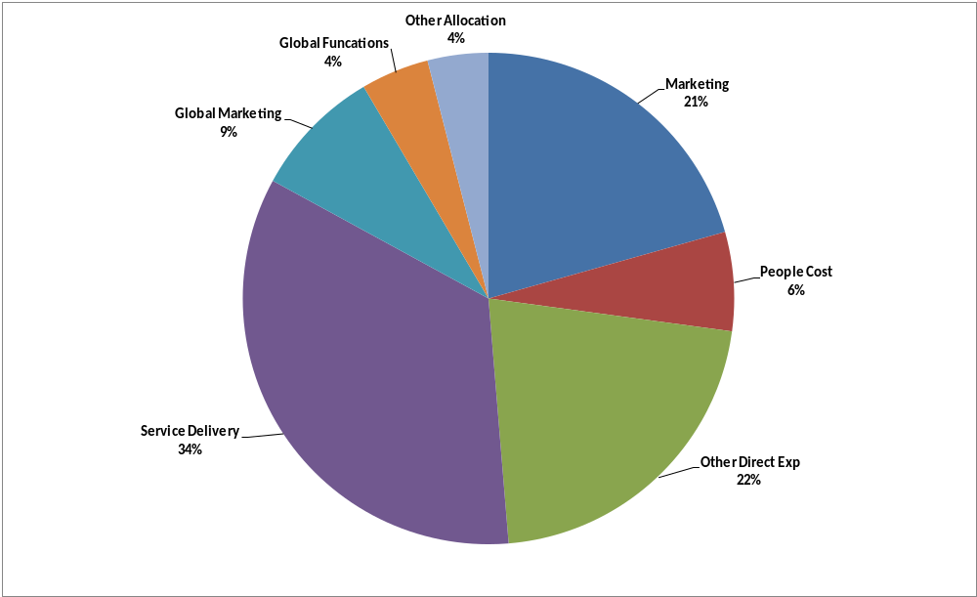
Expenses
Citi Cards 2013 Actual Expenses were $2.9B.
The following chart is the % of Total 2013 Actual Expenses by Category.
Notes:
Review morning topics
Overview of P&L, Drivers (Accounts, Sales, Receivables), Interest, COF, Interchange, Affinity Rebates & Cross-Sell
Agenda for afternoon
NCL, Expenses, Balance Sheet, Competitive Environment
Now let’s look at a major expense line on the P&L: NCL
Review bullet points
Difference between Chapter 7/13 – mention blip we saw a couple years ago when legislation was in place to push more people toward ch 13
Contractual % Losses:
Transition: Lets look at the drivers of NCL

Slide 34
Expense Drivers
Active Accounts
Delinquent Accounts
Servicing Cost per Account
Efficiency / Economies of Scale
Marketing Strategy
Sales / Transaction Volume
  Fraud Losses
  Association Fees
Notes:
Review morning topics
Overview of P&L, Drivers (Accounts, Sales, Receivables), Interest, COF, Interchange, Affinity Rebates & Cross-Sell
Agenda for afternoon
NCL, Expenses, Balance Sheet, Competitive Environment
Now let’s look at a major expense line on the P&L: NCL
Review bullet points
Difference between Chapter 7/13 – mention blip we saw a couple years ago when legislation was in place to push more people toward ch 13
Contractual % Losses:
Transition: Lets look at the drivers of NCL

Slide 35
Net Credit Losses Drivers
Besides ANR, major factors driving losses may include:
Economy (Unemployment , Consumer Debt Burden etc.)
Accounts
  Accounts sourced at the same time out of the same channel tend to have similar performance over time
  Individual account losses peak at 24-36 mos. and settle down
  Major analytical tool is a “vintage analysis” (looking at account behavior based on the year accounts were acquired)
APR - has a strong impact on “select” (who chooses to respond)
Pool - from which accounts were sourced - channel or demographic
Credit Criteria - How tight or loose the credit criteria were
Adverse selection/retention
Notes:
ANR is the biggest driver, but others include :
Aside from ANR, the number 1 driver is economy (review remaining bullets)
Adverse Selection/Retention (vs APR “select”): good credit will be likely to have many more offers, and thus go to competition, while those with bad/declining credit will tend to be more sticky. Retention: a customer may call trying to close his acct because he feels over-extended, and we’ll offer him a higher credit line or other benefits in order to stay.
Transition: There is a proactive process we use to minimize our net credit losses

Slide 36
Net Credit Losses Dynamics
The following represents delinquency flow:
  Bucket 1 - 1-30 days
  Bucket 2 - 31-60 days
    Many accounts flow in and out of buckets 1 & 2 without significant risk of write-off
    Common reason for delinquency is “sloppy” paying, etc.
  Bucket 3 - 61-90 days
  Bucket 4 - 91-120 days
    The Collection group attempts to predetermine accounts headed towards bankruptcy and suggests alternative plans to ensure payment.
  Bucket 5 - 121-150 days
  Bucket 6 - 150-180 days
    Accounts maturing and close to reaching write-off
  Write-offs - 181 days + Post-write-off recovery efforts begin
Notes:
We manage our losses by limiting the number of accounts that ultimately reach write-off status
We organize accounts into 6 “buckets” that represent 30-day periods of time past the last missed payment
Discuss different treatments at different stages
30+ delinquencies: ~5%???
90+ delinquencies: ~2%???
Accounts reaching bucket 6 that ultimately flow to write-off ~75%???
Transition: After COF, NCL is generally one of our highest percentage of expenses. Now we’ll look at some other expenses

Slide 37
Citi Price Rewind
Citi Price Rewind (CPR) is a complimentary price protection program that reimburses card members when a purchase made on their Citi credit card drops in price or is simply advertised online elsewhere for at least $25 less within 30 days of Purchase.
  Searches for lower pricing on behalf of the customer
  Covers both online and in-store purchases
  Manages entire experience via Citi.com/PriceRewind
Program Value: Patent-pending innovation that will differentiate Citi from other consumer card issuers as it is the only proactive price protection in the market today.
  The program benefits card members by saving them time and money when making purchases and it benefits Citi by creating higher share of wallet and increases spend while improving brand image.
Customer Experience: Self explanatory service that does much fo the work for the card member.
  Card members register purchases (i.e. where and when they bought it and how much they paid) on the site
  Participating relailers’ sites (approximately 300) are searched for 30 days from the date of purchase for a lower price.
  Card member can track progress on website and are notified via e-mail whether their purchases are eligible for a refund.
  Card member can submit claims and receipts via the site, by fax or mail.
  If eligible, customers receive a check in the mail for the difference in 10-14 days.
  Refunds are limited up to $250 per claim and total of $1,000 per customer/yr.
Notes:
Other Revenue is primarily fee-driven
Review bullet points
Interchange & Affinity Rebates are sales/driven, and do not impact the customer
Rebates are a contra-revenue
Other fees: Cash Txn Fee, Balcon Fee, Speedpay, FX Fees
Adjustments include Interest & Fee write-offs; other accounting items (FAS 91 Reversals, FAS 140 Gains, etc…)
Transition: Again, as with interest & COF, there are key drivers related to other revenue

Slide 38
Earnings
Earnings Before Taxes (EBT):
EIR minus COF = NIM
Total Revenue minus NCL = NCM
NCM minus Expenses = EBT
Net Income (NI):
NI = EBT X (1 - Tax Rate)
Notes:
Here you see how all the things we’ve talked about take us to the “Bottom Line” or “EBIT (earnings before taxes).
Review calculations
Of course, we also pay taxes on our earnings, so we also look at PCE, which is simply the EBIT less the taxes (tax rate provided by corporate, applied across cards)
Within cards, senior management is focused on EBIT, since that is what we can control, but when reporting up to Global Consumer/Corporate, the focus is on PCE, which is what is reported externally
Transition: So to wrap up this section, here’s another daily double

Slide 39
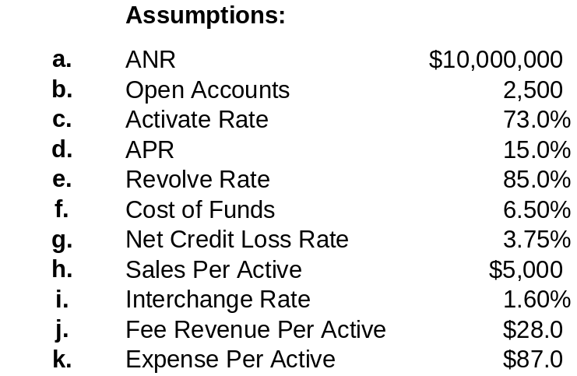
Case Study: Profit & Loss Analysis
SOLVE FOR:
l.
Active Accounts
m.
Total Sales
MARKET PLACE P&L
$
% ANR
n.
Interest
o.
COF
p.
NIM
q.
Interchange
r.
Fee Revenue
s.
REVENUE
t.
NCL
u.
NCM
v.
TOTAL EXPENSE
w.
EBT
Notes:
In the upper left, you can see all the information you’re given (list items).
There are two drivers you’re not given, which will be needed in the calculation below (Active Accounts & Total Sales)
How do we calculate Actives?
Open Accts (2,500) * Activation Rate (73%) = Active Accts (1,825)
How do we calculate Total Sales?
Active Accts (1,825) * sales/Active ($5000) = Total Sales ($9.125MM)
Now you calculate the rest of the lines; calculate both the $ and % ANR (since ANR is $10MM, it shouldn’t be too difficult).
Starting with Interest: what are the drivers?
ANR and EIR% which is…
APR * Revolve Rate
Walk through exercise with class

Slide 40
Financial Analysis Tools

Slide 41
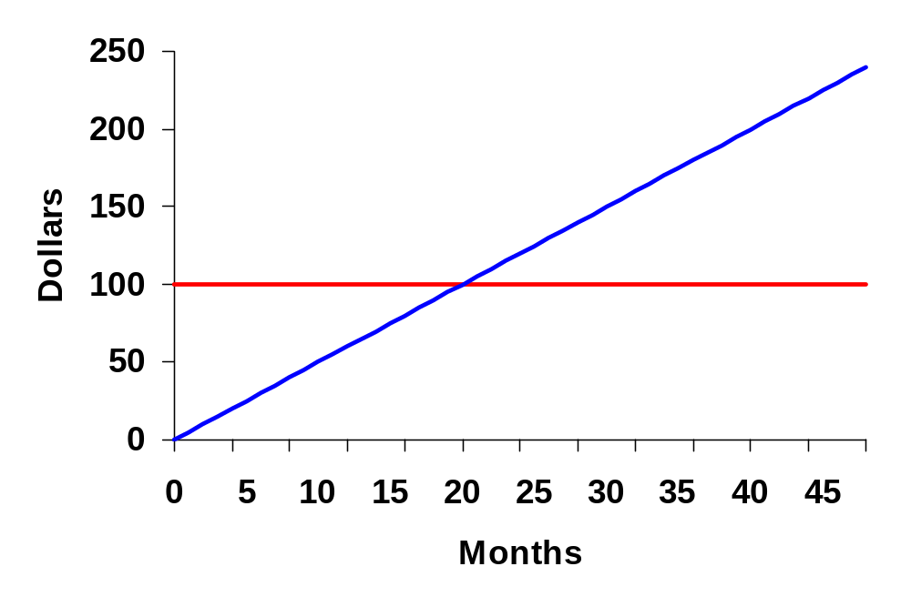
Break-Even
Break-even = Time by which total Net Income (NI) covers the initial investment.
Cumulative NI
Break-Even Point
Initial Investment
Notes:
Break-even analysis is one of two major criteria we use to evaluate the viability of the program
The break-even point is the amount of time it takes for the PCE to cover the initial investment
Describe the graph
Transition: Now let’s look at another important tool for evaluating a program: Return (ROTA) and Net Present Value

Slide 42
ROTA
ROTA is the Return on Total Assets
It is the ratio of the Post Tax Earnings or NI (Net Income) and ANR or Average Net Receivables (Assets)
ROTA = NI / ANR

Slide 43
Net Present Value
The present value of a cash flow is the value of a future cash flow in today’s dollars
  Example: Invest $100 today at 2% and receive $102 in 1 year
  Return or
  Present Value Discount Rate % Future Value
  $100 2% $102
The discount rate is the required rate of return based on the level of risk taken. Higher returns expected and higher discount rates used for riskier / more uncertain cash flows.
  Bank Deposit versus Stock Market
  2% 12%
The Net Present Value (NPV) of a project is the sum of the present values of the expected cash flows on the project, net of the initial investment
The NPV hurdle with the appropriate level of discount rate is > $0

Slide 44
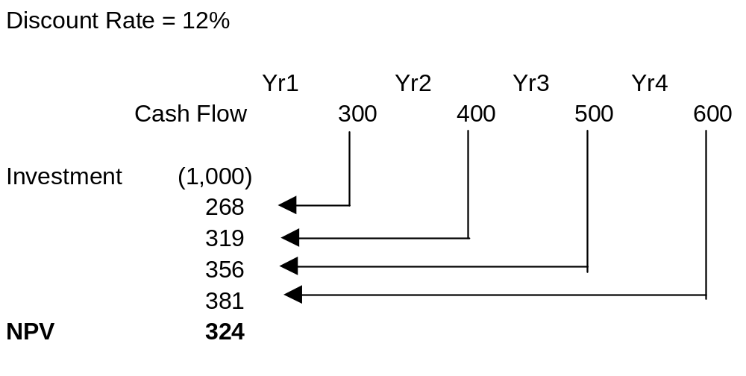
Net Present Value Example

Slide 45
Risk Capital

Slide 46
Risk Capital Summary
Risk Capital is the level of capital a bank determines is necessary for unexpected economic losses during extreme events (over a one-year horizon).
Risk Capital covers three main types of risks: Credit, Market and Operational.
Citigroup’s total Risk Capital for 3Q13 was $88.8Bn of which $5.4Bn is assigned to Citi Cards (6%).
Risk Capital is highly correlated to asset quality. This means that exposure management on high risk segments is critical.

Slide 47
Marketing Spend Analysis

Slide 48
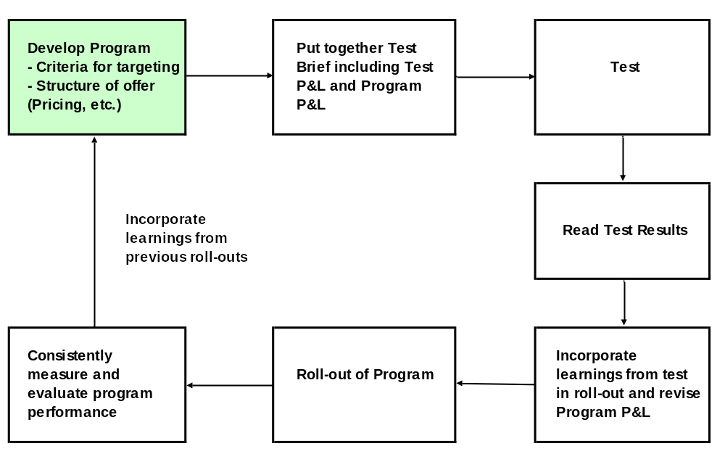
Marketing Spend Analysis – Using P&Ls
P&Ls are used throughout the development of marketing campaigns to assess the profitability of various offers and strategies.

Slide 49
Targeting
Targeting is:
  Determining which offers to make to which set of customers
  Determining which customers we want to retain and through what offers/programs
An account is targeted for an offer based on:
  Credit Criteria
  Profitability – Past/Future
  Customer Needs
Current Target Segments are:
  Borrowers / Revolvers – Mass Market
  Spenders / Reward Seekers - Affluent

Slide 50
Testing
Testing is small volume campaigns to assess the potential of the offer or program.
  Generally structured as Test vs. Control to read incremental changes on the new campaign (test) vs. the control group.
Types of Testing include:
  Universe Expansion
  Creative Designs
  Pricing Offers and Terms
Testing should be:
  Cost effective
  Provide learnings for significant roll out potential
  Only for programs with roll out potential

Slide 51
Pro Forma Financial Evaluation / PRWs
Pro forma financial P&Ls are developed prior to execution of a marketing program to assess expected profitability and return.
P&Ls for roll-out offers are based on:
  Similar past programs and/or
  Test Results
P&Ls for test offers are based on similar past programs and business judgment.
Sensitivities are run to determine the impacts of various assumptions on the overall profitability and return.
PRW (Program Request Write-Up) – the final marketing campaign approval package containing the total financial impact of the program.

Slide 52
Program Performance Evaluation
After execution, analyze the results and use the learning to execute the next program even more profitably.
Profitability Analysis
  Tests and ECM programs based on incremental profitability - Test vs. Control results
  Acquisition programs measured via Month on Book analysis.
  The most important measures in determining profitability are:
    Pricing (APR / Fees)
    Sales
    Revolve Rate
    ANR
    Attrition Rate
    NCL / Risk
    Expenses
  Business judgment is also used to determine successful offers based on balancing specific goals such as profitability, ANR growth, ROTA, NPV and NCL hurdles.

Slide 53
Appendix

Slide 54
Credit Card Act of 2009
The Credit CARD Act of 2009 is a federal law passed by the United States Congress and signed by President Obama on May 22, 2009. It is comprehensive credit card reform legislation that aims "...to establish fair and transparent practices relating to the extension of credit under an open end consumer credit plan, and for other purposes."
Act was phased in over 2009 and 2010.
Highlights of the credit card law:
  Limits interest rate increases
  Limits universal default
  Right to opt out
  Limited credit to young adults
  More time to pay monthly bills
  Clearer due dates and times
  Higher interest balances paid first
  Limits on over-limit fees
  No double cycle billing
  Late fee restrictions
  Disclose impact of making only minimum payments
Notes:
ANR is the biggest driver, but others include :
Aside from ANR, the number 1 driver is economy (review remaining bullets)
Adverse Selection/Retention (vs APR “select”): good credit will be likely to have many more offers, and thus go to competition, while those with bad/declining credit will tend to be more sticky. Retention: a customer may call trying to close his acct because he feels over-extended, and we’ll offer him a higher credit line or other benefits in order to stay.
Transition: There is a proactive process we use to minimize our net credit losses

Slide 55
Credit Card Changes: Impact to P&L
Highlights and major impacts to Revenue from Credit Card Act and other adjustments to credit card rules:
Risk Based Balances – 45 days advance notice of the change, cannot change rate on existing balances.
OCL Fees – cannot be charged unless customer opts in.
Delinquency fees – statements need to be sent out 21 days in advance of due date and restrictions on late fee charge amounts.
Payment Hierarchy changes – allocation of payment changes.
Speedpay / Pay by Phone – restricts pay by phone charges.
Does not allow Annual Fees for inactivity.
Balances with Floors – does not allow minimum floors on rates.
Mid Tier Impacts
Notes:
ANR is the biggest driver, but others include :
Aside from ANR, the number 1 driver is economy (review remaining bullets)
Adverse Selection/Retention (vs APR “select”): good credit will be likely to have many more offers, and thus go to competition, while those with bad/declining credit will tend to be more sticky. Retention: a customer may call trying to close his acct because he feels over-extended, and we’ll offer him a higher credit line or other benefits in order to stay.
Transition: There is a proactive process we use to minimize our net credit losses

